Slide 1

Mining Social Media to support Traffic Forecasting
Code Samples & Exploratory Analysis
Ahmad Ammari

Slide 2
outline
OPTIMUM: Overview, Objective & Task
Solution: Social Media – Aided Traffic Forecasting Engine
Solution Components:
Data Streaming Adaptors
Traffic Flow and Average Speed data streams
Twitter data streams
Tweet Relevance Filtration Component
Sentiment Classification Component
Timeline Exploration App
Forecasting Flow & Speed with Linear Regression Experiments

Slide 3



OPTIMUM: Overview & Task
EU-Funded Project
18 Partners, 8 EU countries
Objectives
Bring proactive mobility to modern transport systems
Improve transit, freight transportation, traffic connectivity across Europe
UK Partners: UoW & BCC
My task: Research traffic forecasting improvement via mining social media data sources

Slide 4
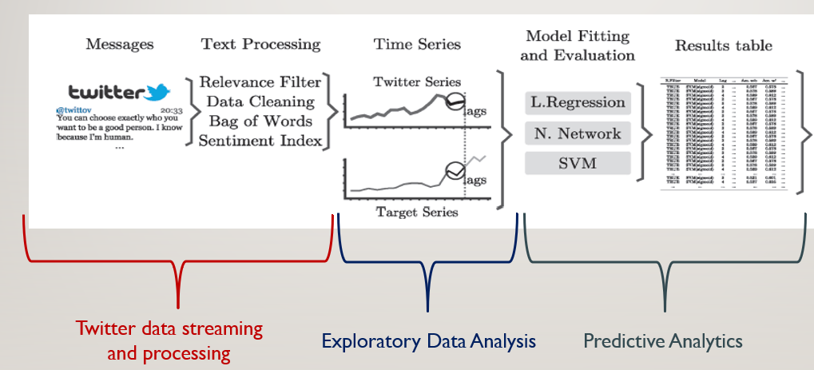
Solution: SM – Aided Traffic Forecasting Engine
Generic Framework

Slide 5
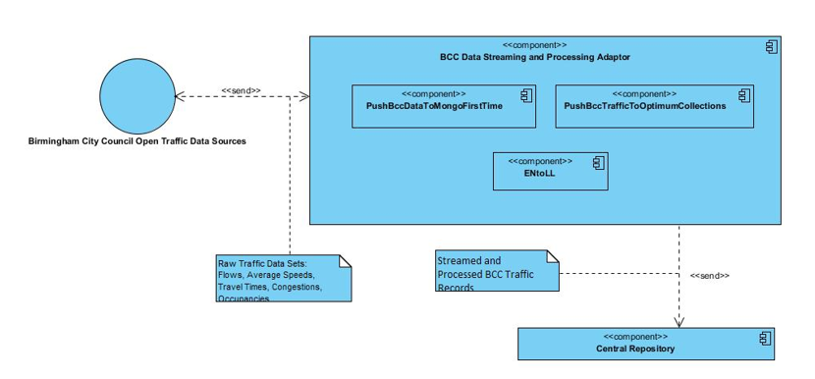
Sensor Data Streaming and Processing Component

Slide 6
Sensor Data Streaming and Processing Component
Implementation Specs
Scripts Overview
Language: Python 2.7
Main Libraries: pymongo, json, urllib2, pyproj
Datastore: MongoDB
Trigger: 1-minute Cronjob on Windows Server 2012
PushBccDataToMongoFirstTime: establish the database connections, create the database collections, and insert the data sets for the first time into empty data collections
PushBccTrafficToLocalCollections: update the datastore periodically with newly updated records
ENtoLL: convert geolocation data coordinates from the British National Grid (BNG) to latitude and longitude
pushBccRecords: Push existing BCC Traffic records on UoW server datastore in 5 traffic-related collections to Optimum VM server mongoDB

Slide 7
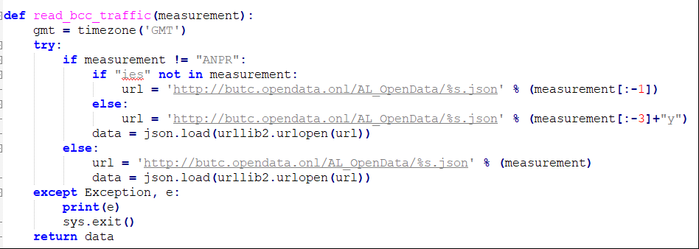
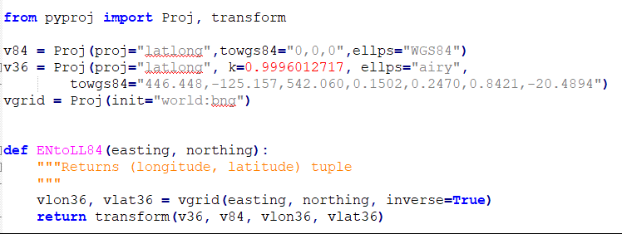
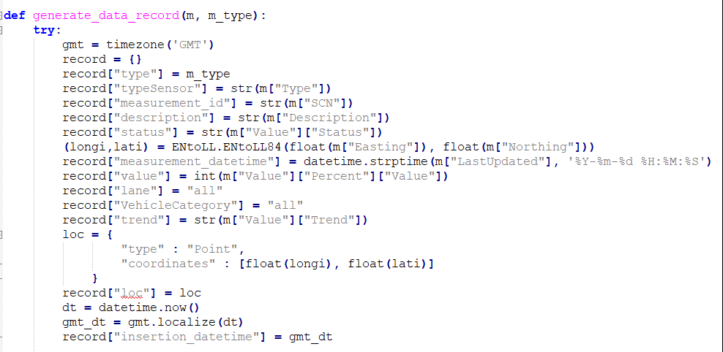
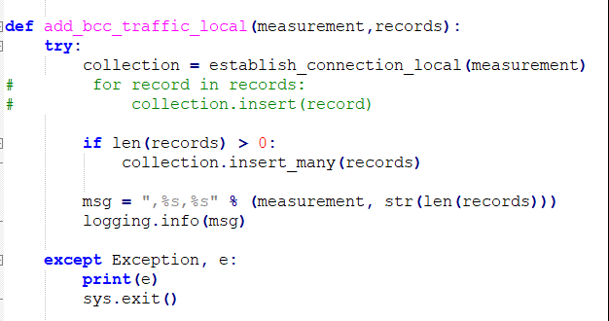
Code Samples
Reading Sensor Data
Converting Geolocation Attributes
Generating Data Record
Writing Records to MongoDB

Slide 8
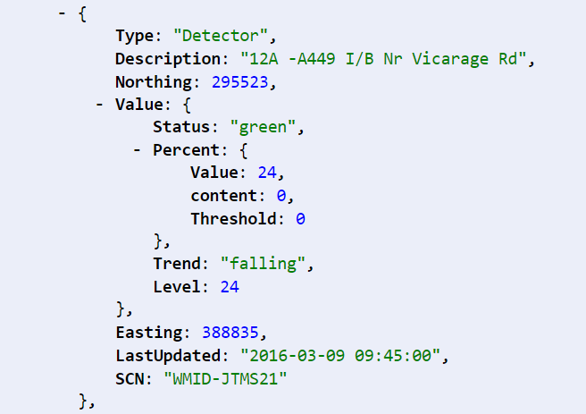
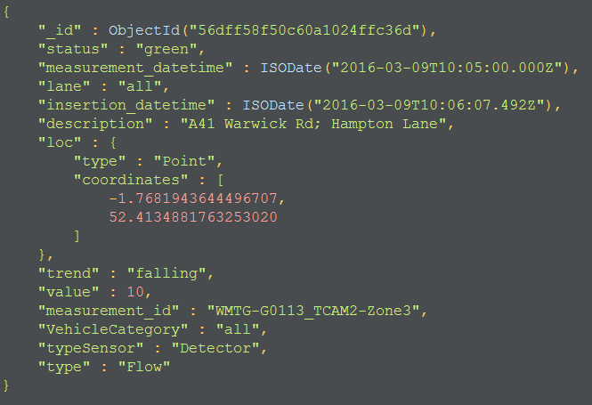
I/O Structure
Input Record
Output Record

Slide 9
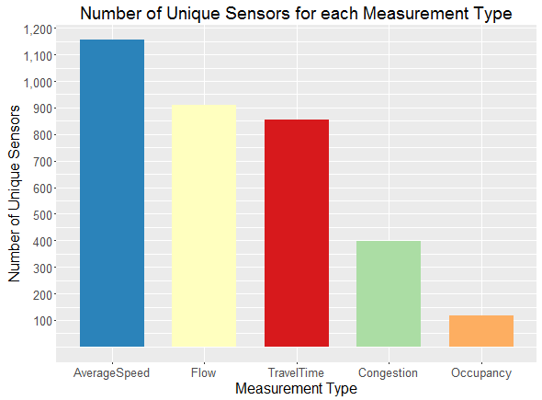
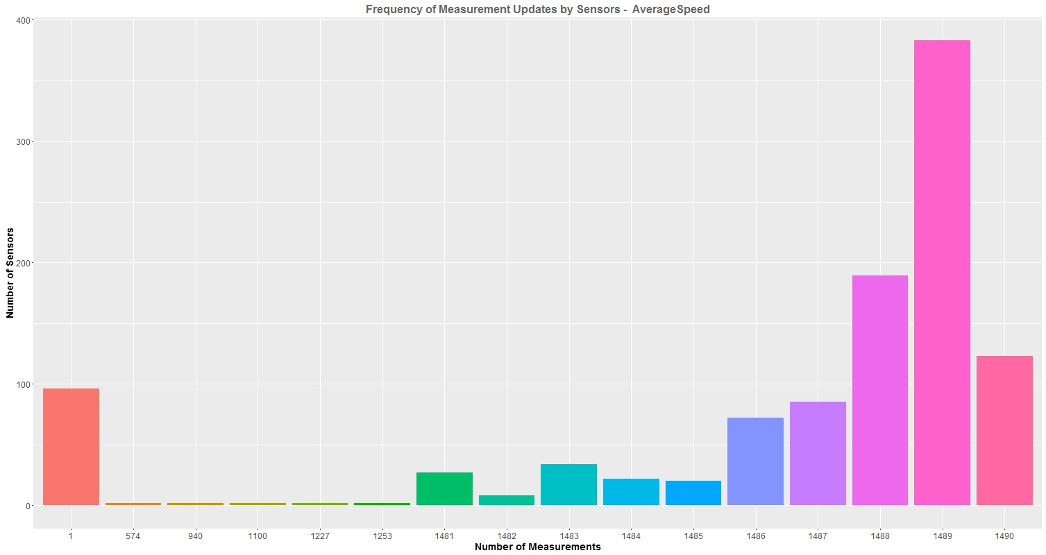
Data Exploration
Distribution of Unique Sensors
Frequency of Sensor Updates for Average Speed Measurements

Slide 10
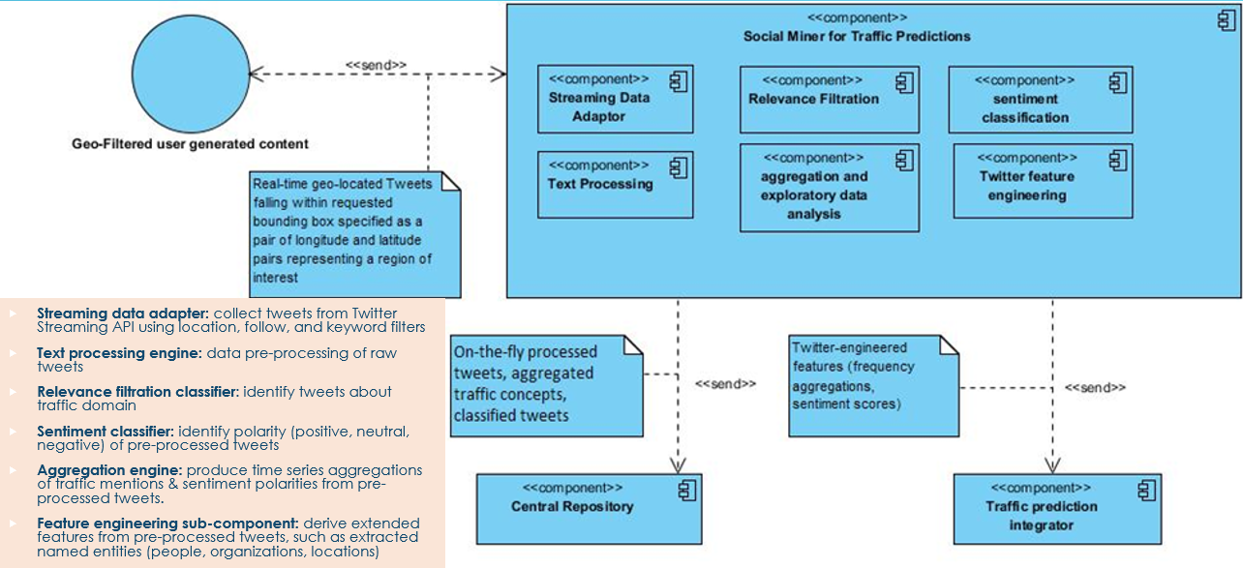
Social Miner for Traffic Forecasting

Slide 11
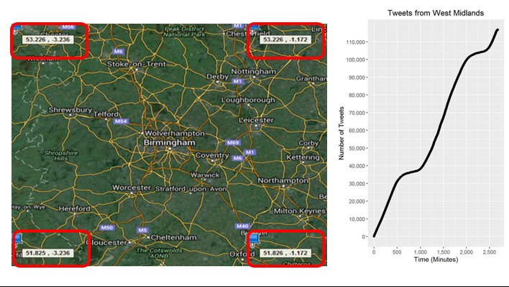
Twitter Data Streaming Component
Implementation Specs
Scripts Overview
Language: Python 2.7
Main Libraries: pymongo, tweepy, json
Datastore: MongoDB
Trigger: 1-minute bash script to reactivate streaming process if stopped
Stream_WM_tweets: location-based streaming of tweets authored within West Midlands, UK
• Stream_UK_accounts: gazetteer-based streaming of tweets authored by given accounts or containing given phrases, key-words, or hashtags
WM geo-coordinates
Traffic keywords
birmingham accident | cotteridge bearwood | robinhodln yardly | walsal road | wolverhampton road
birmingham congestion | cotteridge stechford | roundabout a446/b4114 | walsall road | wood bearwd
birmingham delay | cotteridge yardly | roundabout a5/a452 | walsall street | wood stechfd
birmingham delays | country route | roundabout a5/a461 | walsallrd pbeeches | wordsworth road
birmingham roadworks | coventry road | roundabout a5/b4154 | warwick road | wrentham street
birmingham roadwork | coventry road | roundabout m6 | warwick road | wy alcester
birmingham traffic | cw bearwood | roundabout m6/a452 | warwickrd 5b | yardley wood

Slide 12
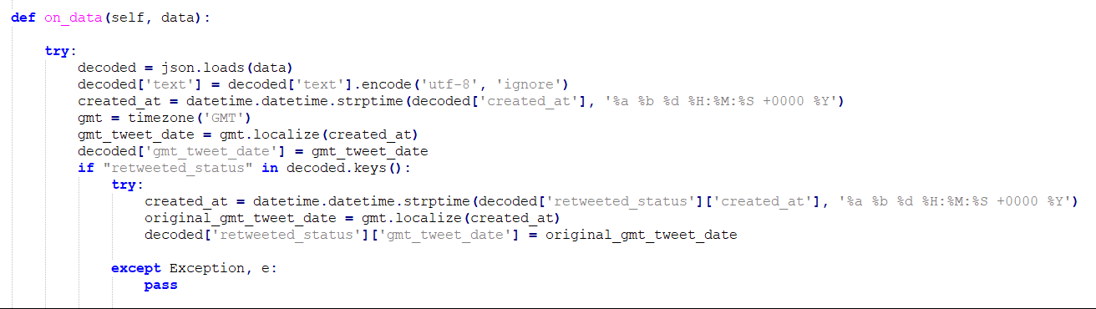
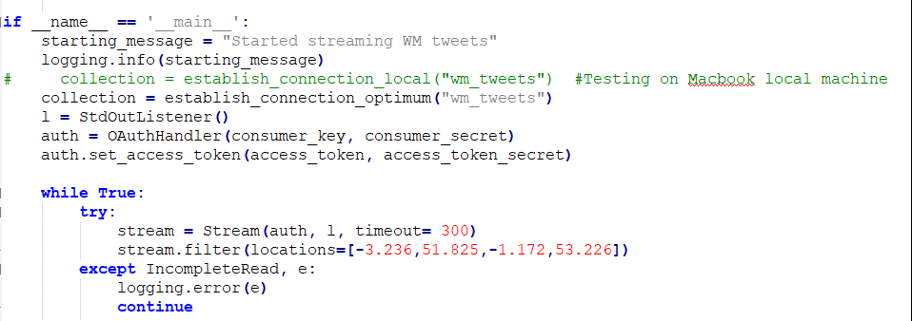
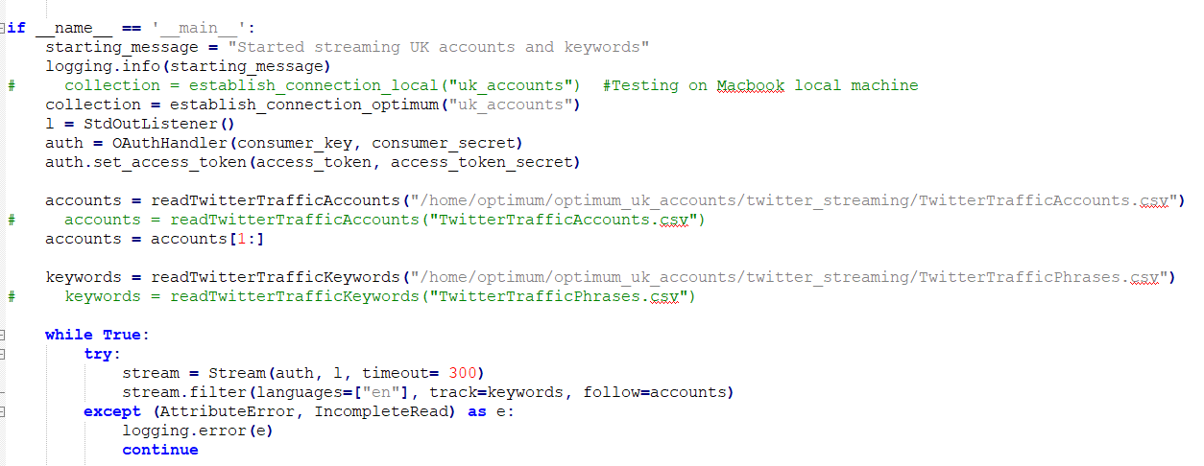
Code Samples
Stream Processing
Streaming Geolocated Posts
Streaming Timelines / Mentions

Slide 13
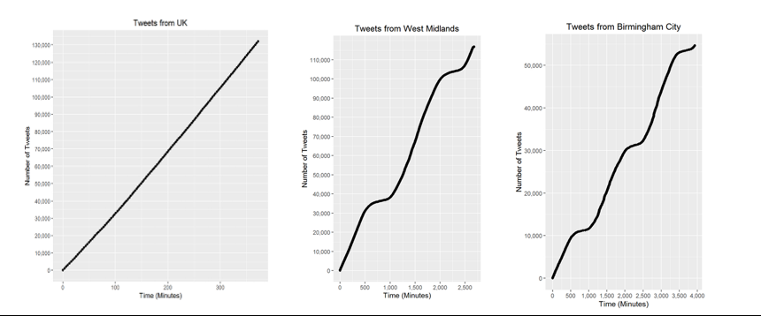
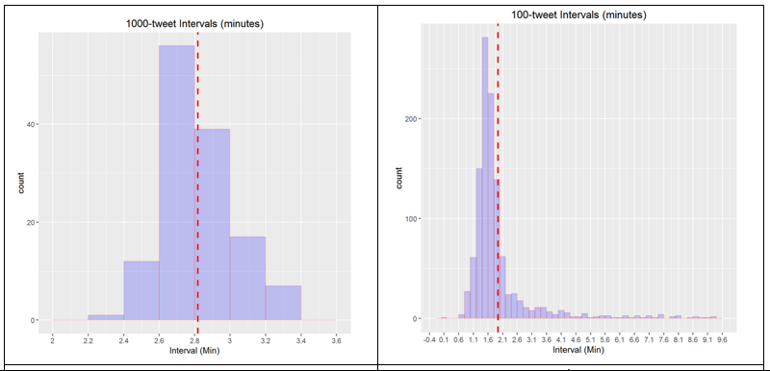
Data Exploration
Streaming
Rates
UK
WM
Streaming
Intervals

Slide 14
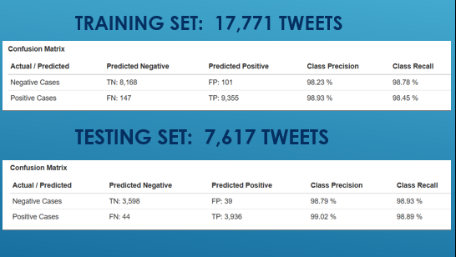
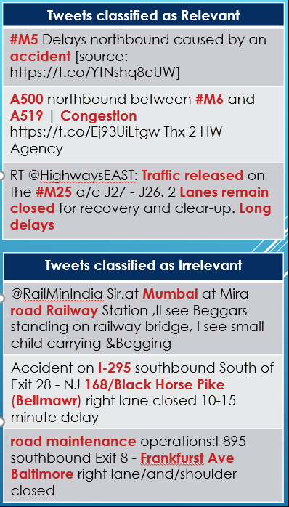
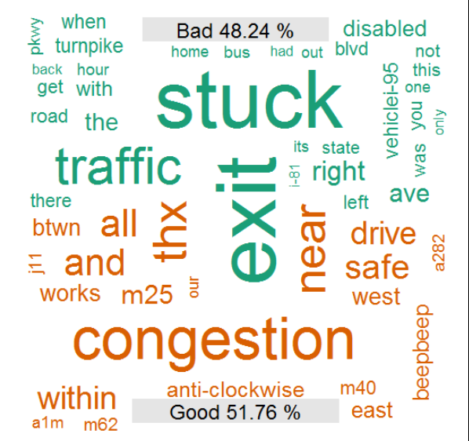
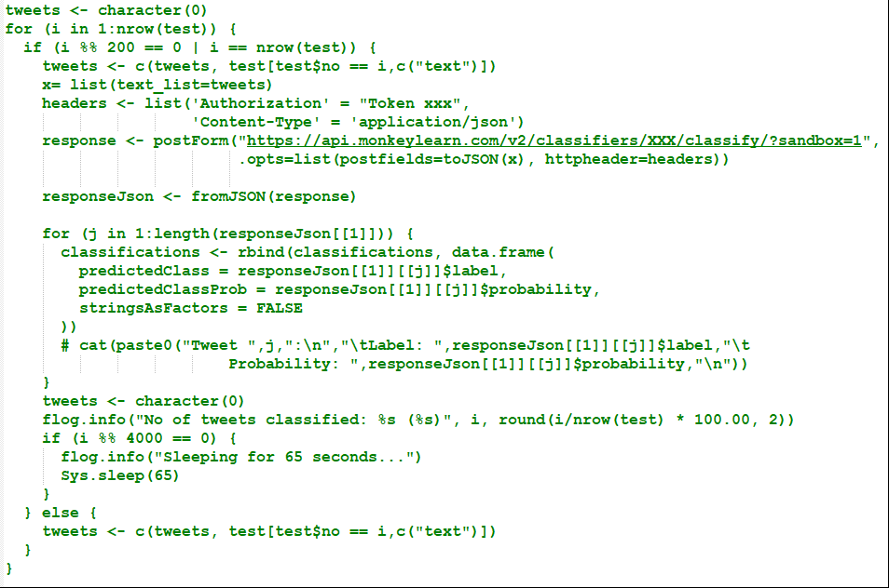
Tweet Relevance Filtration Component
Training / Testing Experiments
Evaluation
Prediction Sample
Training: MonkeyLearn GUI
Testing: MonkeyLearn API / R interface
Approach: Binary Classification
Algorithms: Multinomial Naïve Bayes, Support Vector Machines
Scoring of on-going streamed data: Python, Scikit-Learn, NLTK, threading, pymongo
Scoring of Testing Data
Word
Cloud

Slide 15
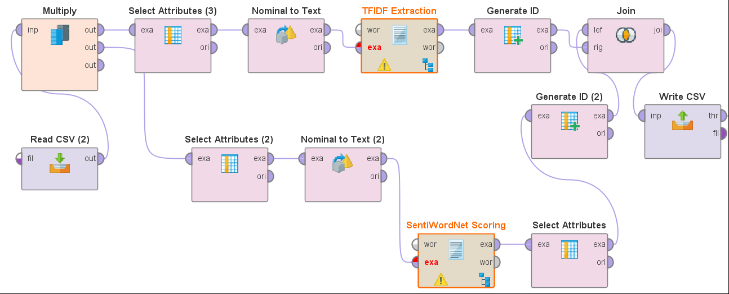
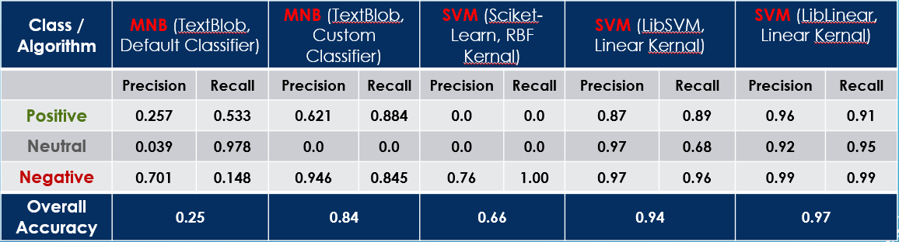
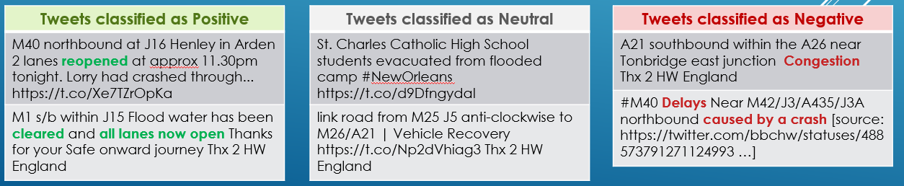
Tweet Sentiment Classification Component
Sentiment Scoring of Training Data
Training / Testing Experiments
Processing Tool: RapidMiner
Lexicon: SentiWordNet
Tools: Scikit-Learn, TextBlob
Classifiers: MNB, SVM, ANN, DT
Prediction Sample

Slide 16
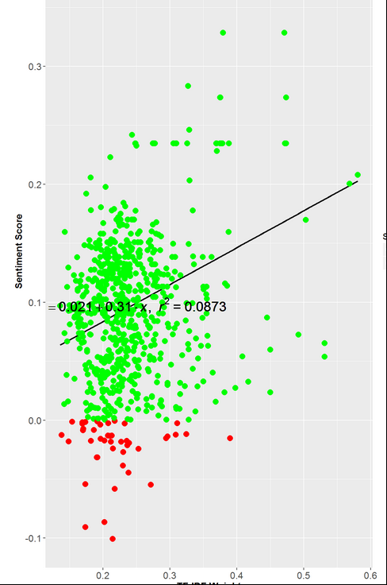
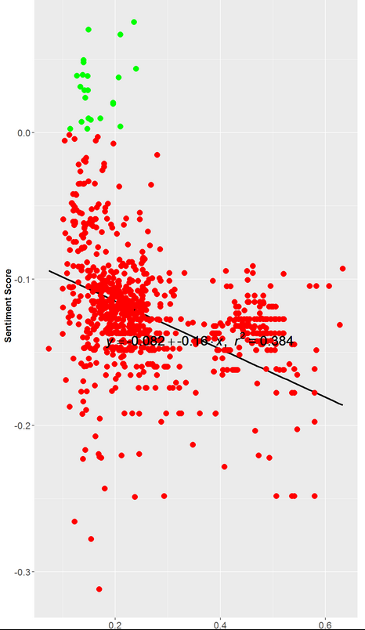
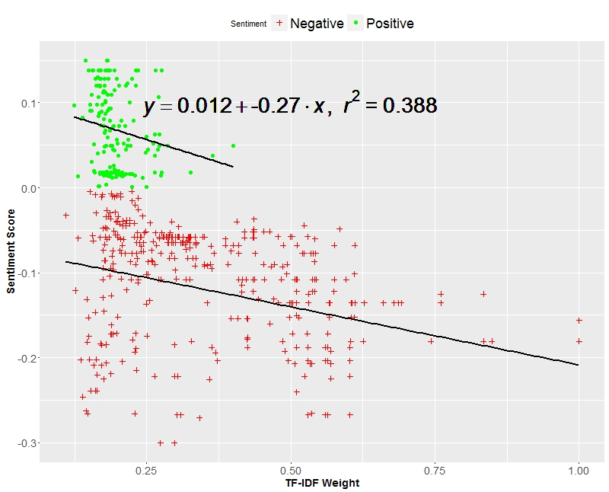
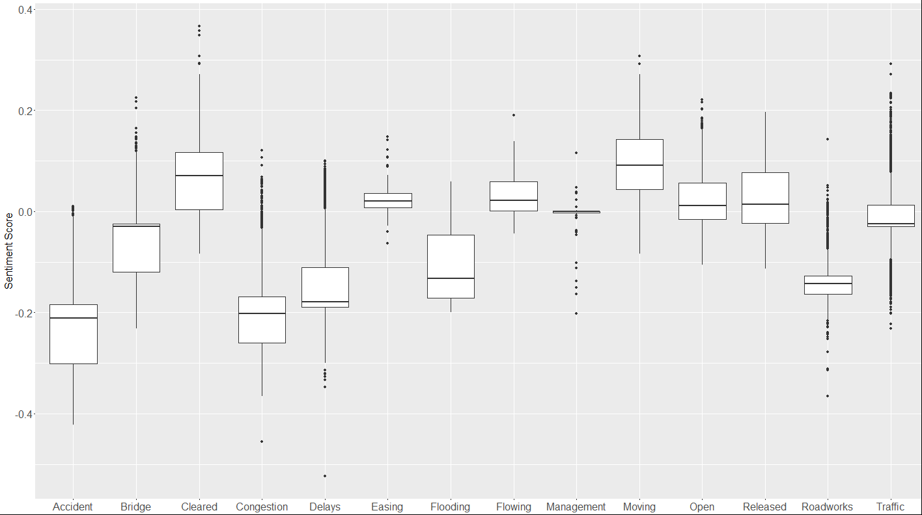
Data Exploration
Term: Cleared
Term: ROADWORKS
Term: ACCIDENT
Correlation of TFIDF weights & Sentiment Scores
Sentiment Score Medians across Traffic Concepts

Slide 17
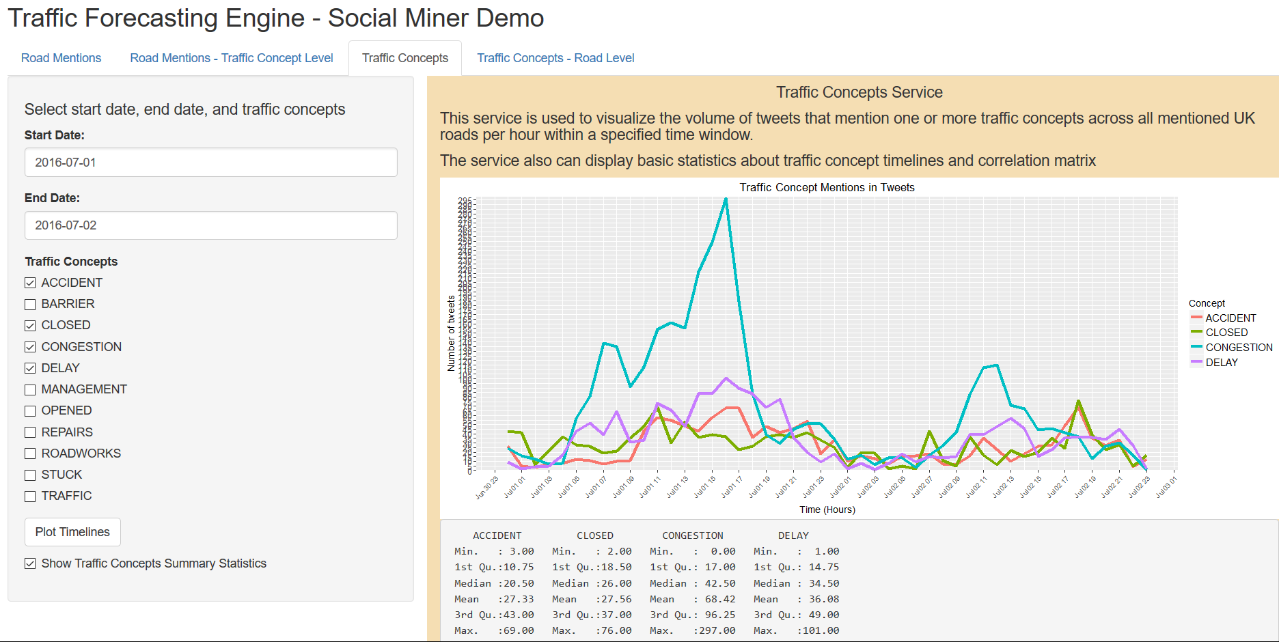
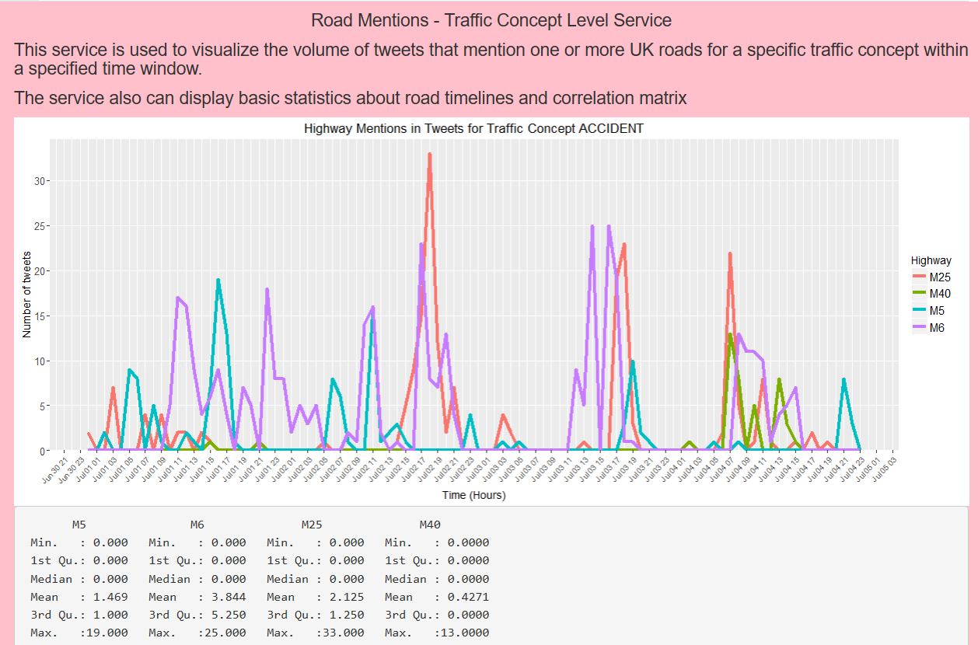
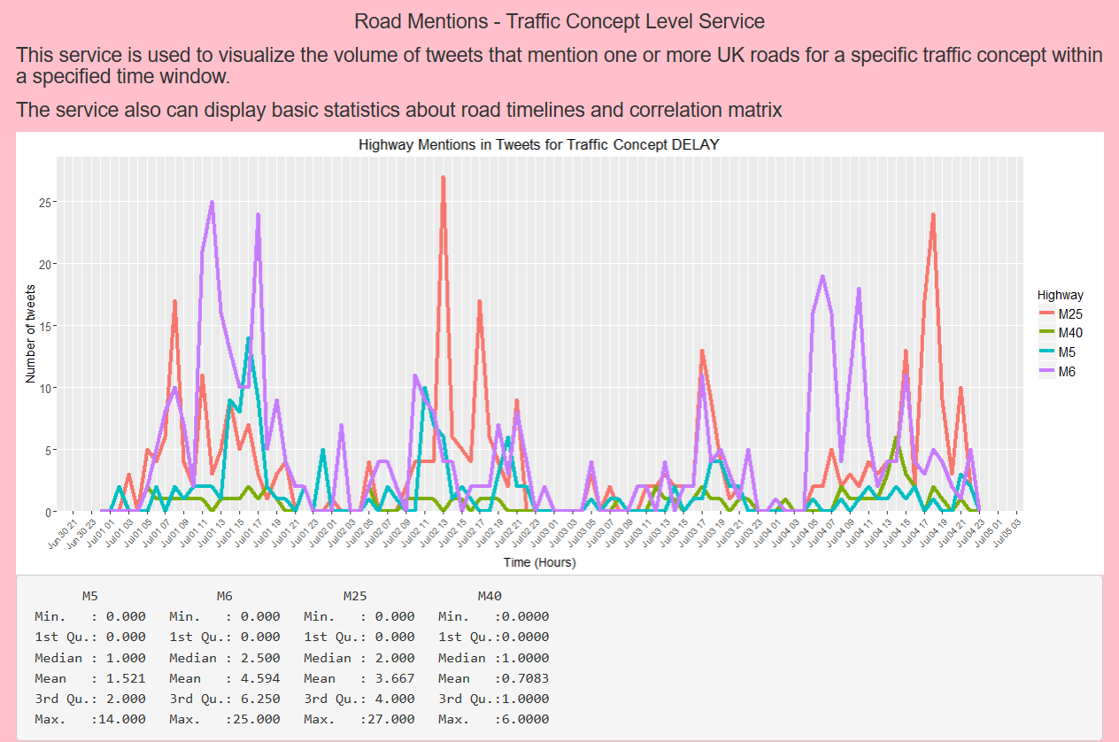
Timeline Exploration R Shiny App
Implementation Specs
Scripts Overview
Language: R
Main Libraries: shiny, rmongodb, ggplot2
Datastore: MongoD
app: Main Application GUI Interface
HighwayAggregationsMongo: hourly counts of given UK road name mentions on Twitter
TrafficAggregationsMongo: hourly counts of given Traffic concept mentions on Twitter
HighwayAggregationsOneConceptMongo: hourly counts of given UK road name mentions with one traffic concept mention on Twitter
TrafficAggregationsOneRoadMongo: hourly counts of given UK Traffic concept mentions with one road mention on Twitter
App GUI Interface
CONSEPT: ACCIDENT
CONSEPT: DELAY

Slide 18
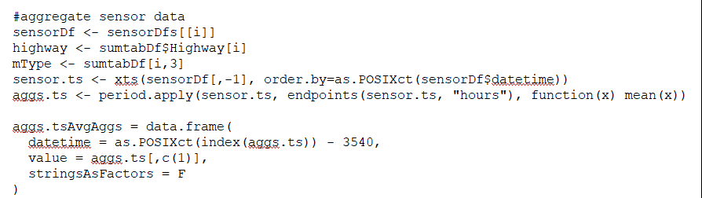
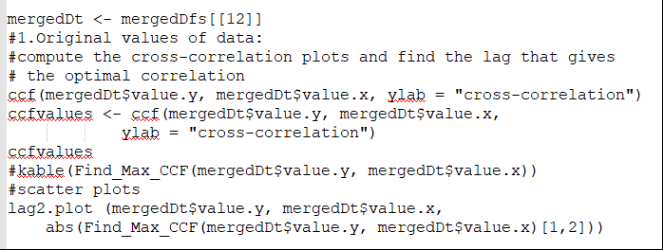
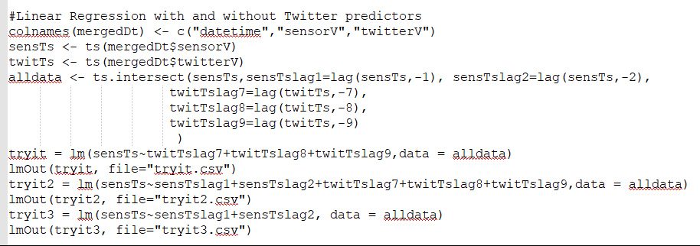
Linear Regression for Forecasting Flow & Speed
Experiment Specs
Hourly aggregates code example
Language: R
Main Libraries: xts, tseries, rmongodb, ggplot2
1st time-series: hourly aggregates of average flow / average speed sensor values
2nd time-series: hourly aggregates of road / traffic concept mentions on Twitter
Cross-correlation code example
Linear regression code example

Slide 19
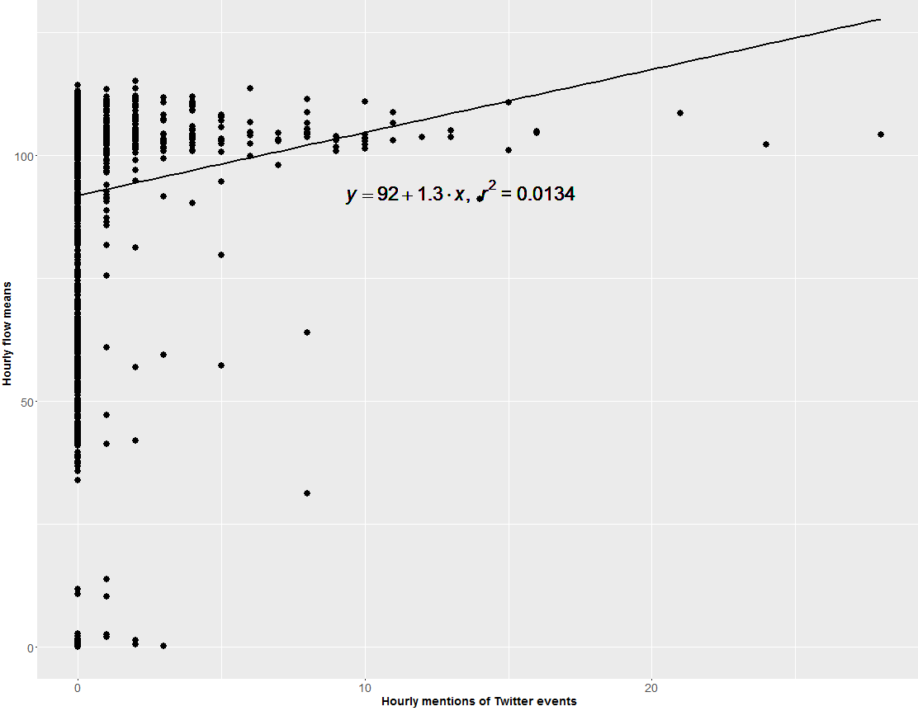
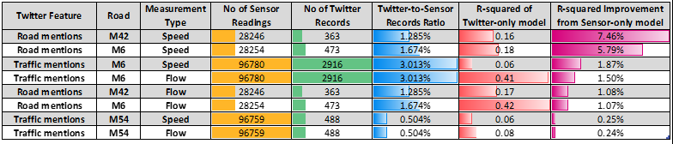
Evaluation
Influence of Twitter road mentions on forecasting traffic average flows & speeds
Regression of {Accident, Congestion, Delay} mentions and average speeds
Summary of Experiments

Slide 20
Summary
Twitter-derived features as predicting variables to traffic forecasting models have contributed to an increase in the R-squared values from the values obtained by sensor-only models
Forecasting improvement ratios are relatively similar to those reported in similar literature studies
Significant improvements are achieved mostly when:
the measurement type is the average speeds of the vehicles rather than the vehicle average flows
using road mentions, rather than traffic concept mentions, as Twitter-derived features

